Slide 1
Financial Forecasting using Deep Learning
Anuar Maratkhan

Slide 2
Problem
Problem definition:
Predict future actions for algorithmic traders in stock market based on the previous prices
Problems with the data:
Lots of noise in data
Not enough data
Imbalanced data
Undefined range of data
Notes:
First, show the problem definition, then problem with the data (with transitions/animations)

Slide 3
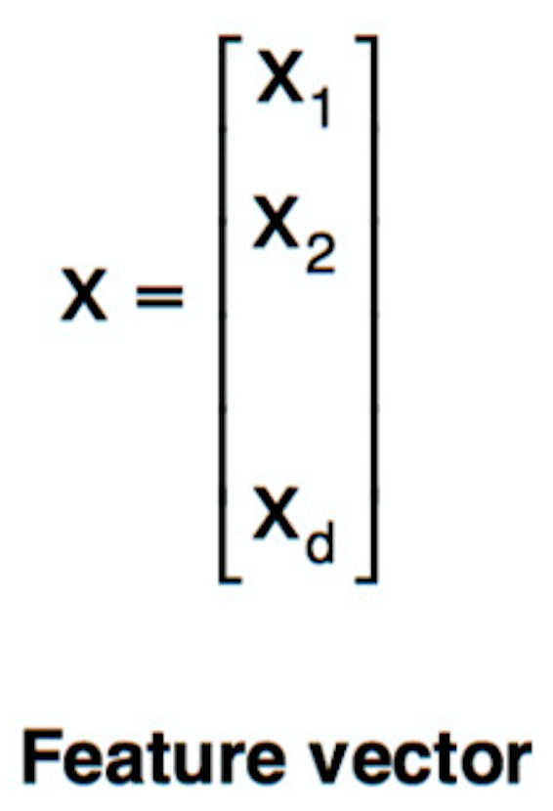
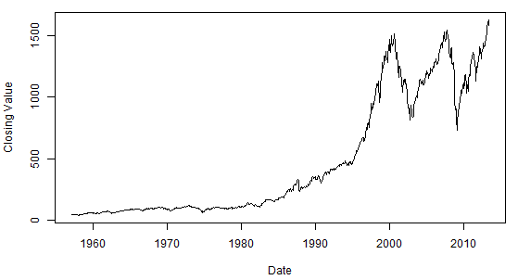

Solution
Convert time-series to feature vectors and process them with convolutional neural network
CNN
Notes:
Put CNN at the most right

Slide 4
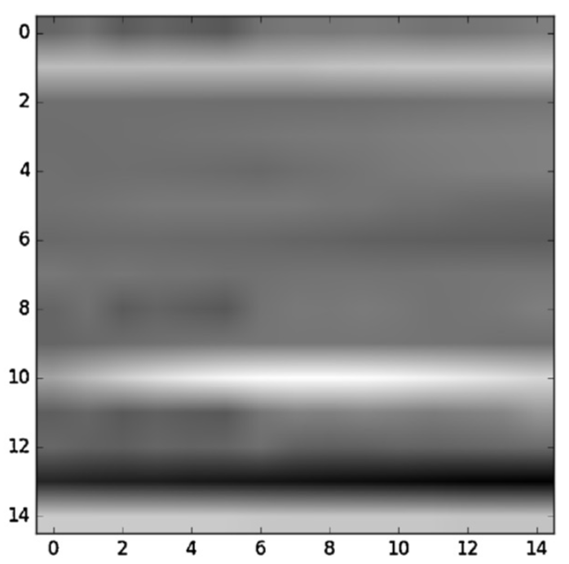
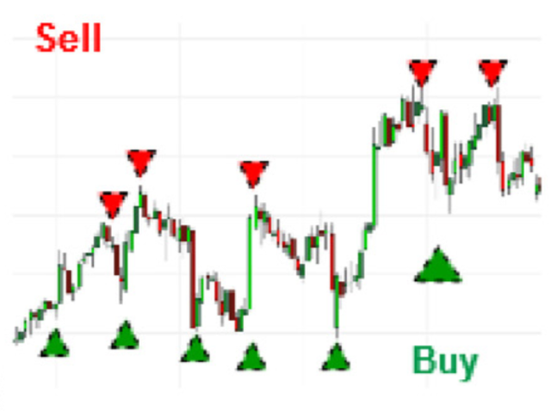
CNN-TA Methodology
Dow 30
Indicators
Financial evaluation
CNN
Classification
[Sezer, Ozbayoglu, Algorithmic ﬁnancial trading with deep convolutional neural networks, 2018]

Slide 5
CNN-TA Methodology
Paper results: 0.58, 12% annual return
Our results: 0.60, 8.16% annual return
 | Hold | Buy | Sell
Hold | 52364 | 18684 | 23592
Buy | 1268 | 5175 | 3
Sell | 1217 | 8 | 5059
 | Hold | Buy | Sell
Hold | 54130 | 18110 | 20543
Buy | 1469 | 5039 | 3
Sell | 1798 | 1 | 4663
[Sezer, Ozbayoglu, Algorithmic ﬁnancial trading with deep convolutional neural networks, 2018]

Slide 6

Proposed Methodology
Dow 30
Indicators
Financial evaluation
CNN
Classification

Slide 7
Model
One-dimensional convolutional neural network
Logistic regression with regularization
Support Vector Machine with ‘rbf’ kernel
Gradient boosted trees

Slide 8
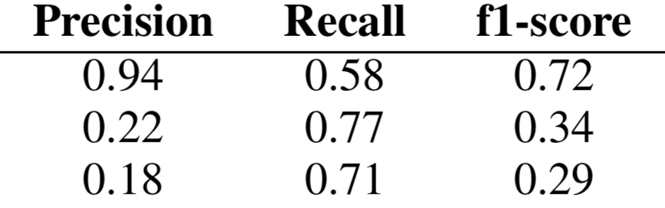
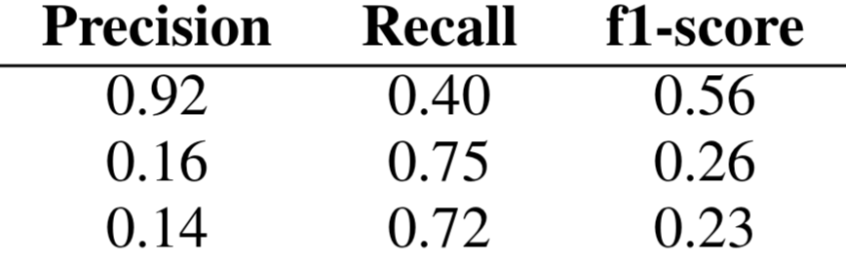
Results
Previous results: 0.60, 8.16% annual return
Proposed results: 0.44, 8.45% annual return

Slide 9
Results
Logistic Regression: 0.87, 2.53% annual return
Support Vector Machine: 0.26, 4.90% annual return
Gradient boosted trees: 0.85, 5.59% annual return

Slide 10
Problems we have encountered
Normalization method from paper
Mislabeled images with os.listdir

Slide 11
Conclusions and Future Work
Conclusion:
We have improved the baseline in terms of financial performance
However, there is a slight gap in terms of computational performance
Future Work:
Improve trading strategy
Improve the architecture
Stack CNN and LSTM to capture temporal features
Notes:
Tell about conference application
Provide one-sentence statement that we have improved the baseline

Slide 12
Dow 30 stocks
AAPL
AXP
BA
CAT
CSCO
CVX
DIS
DWDP
GE
GS
HD
IBM
INTC
JNJ
JPM
KO
MCD
MMM
MRK
MSFT
NKE
PFE
PG
TRV
UNH
UTX
VZ
WMT
XOM

Slide 13
Indicators
RSI
Williams %R
WMA
EMA
SMA
HMA
Triple EMA
CCI
CMO
MACD
PPO
ROC
CMFI
DMI
PSI

Slide 14
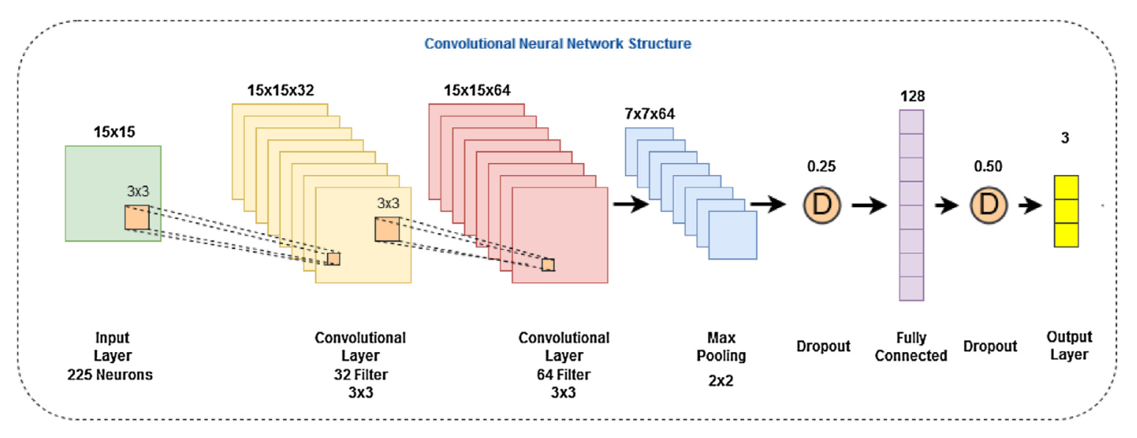
Le-Net architecture
[Sezer, Ozbayoglu, Algorithmic ﬁnancial trading with deep convolutional neural networks, 2018]

